Slide 1

Financial Markets:
Optimizing Options Trading
One Month Before Expiration

Slide 2
What is an Option?
A contract that grants the right to buy or sell the “underlying” stocks at a fixed price (the strike price) within a term, the expiration.
Put option example:
Bought stock A at price $10
Price goes up to $15
Buy put options at strike price = $15
to lock-in our profit (right to sell at $15)
And many other ways to use them…

Slide 3
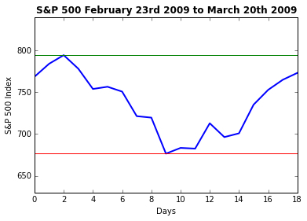
When is best to trade Options?
Most of option trades are made on price minimums and maximums of the stock.

Slide 4
The Data
35 years of daily and weekly S&P 500 index data
25 years of daily data on options on S&P 500
426 samples (months) to train the model
32 input variables: mostly moving averages and some customized indicators
All data available for free (Google Finance, Yahoo finance,…)

Slide 5
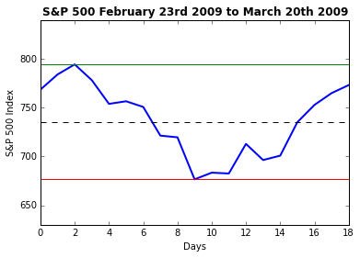
The Models
Four independent Regression Models
using Ridge, Lasso, Elastic Net
and Cross Validation
Predict the price maximum (green line)
Predict the price minimum (red line)
Predict the price movement width
Predict the middle point (dashed line)
June 2015 predictions:
Movement middle point: -1.1% against actual -0.8%
Price movement width: 2.2% against 2.9%

Slide 6
The “Fifth – Element”
An Indicator I developed to measure the distance (in %) between the current price and the most “crowded” options strikes, that tend to attract the price when expiration is approaching.
It has to be checked daily, and matched with the predicted price range
March 9th 2009: S&P 500 = 676.53
5th Element indication: +11.6%
March 20th 2009 (options expir):
S&P 500 = 768.54 (+13.6%)

Slide 7
The Perfect Trade in Graphics
3 conditions to be verified:
Current Price outside the Predicted Price Range
5th Element pointing to the Price Range
5th Element Value > 1%
Predicted price “roof”
Predicted price
range (+/- 2.1%)
including 80% of
actual samples
Predicted middle
point (+/- 1.6%)
>+1%
5th Element
Predicted price “floor”
Current price level

Slide 8
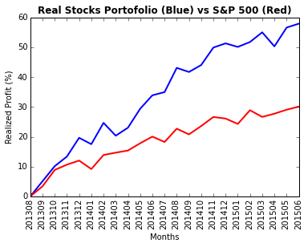
The Outcomes
Every “perfect” scenario assured 100% of expected profit
The perfect scenario occurred in about 52% of the analyzed samples, but indications provided by the model can be useful even in not perfect scenarios
The actual results from a subset of the model are a good proof of the model potential:

Slide 9

Thank you!
Marco Lunardi
marcolunardi.github.io
marco@marcolunardi.com

